Slide 1

Accessibility in Gaming Panel
DragonCon 22’

Slide 2
Moderators and Panelists
Jordan Plank – Moderator – evolve
Mike Matlock – Panelist – DAGERSystem – Freelance News Editor
Dr. Mitchell Tepper – Panelist – President of United Spinal Atlanta Adaptive esports Program
Jared Grier – Panelist – Assistive Technology Rehabilitation Engineer/NERVE Gaming

Slide 3
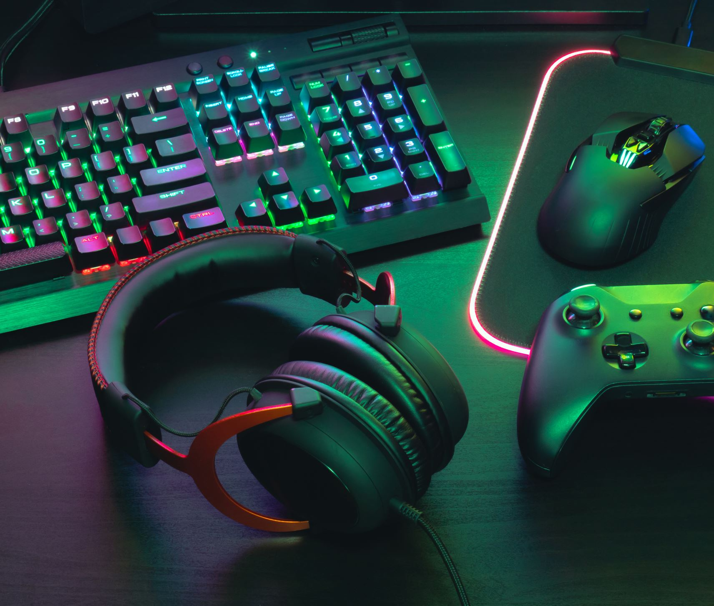
Discussion Categories
Current State of Accessibility in Gaming
Utilizing Accessible Gaming Software
Obtaining and Setting Up Adaptive Gaming Equipment
Accessible esports Tournaments and Leagues
The Future of Accessibility in Gaming
Live Demonstration
Q & A

Slide 4
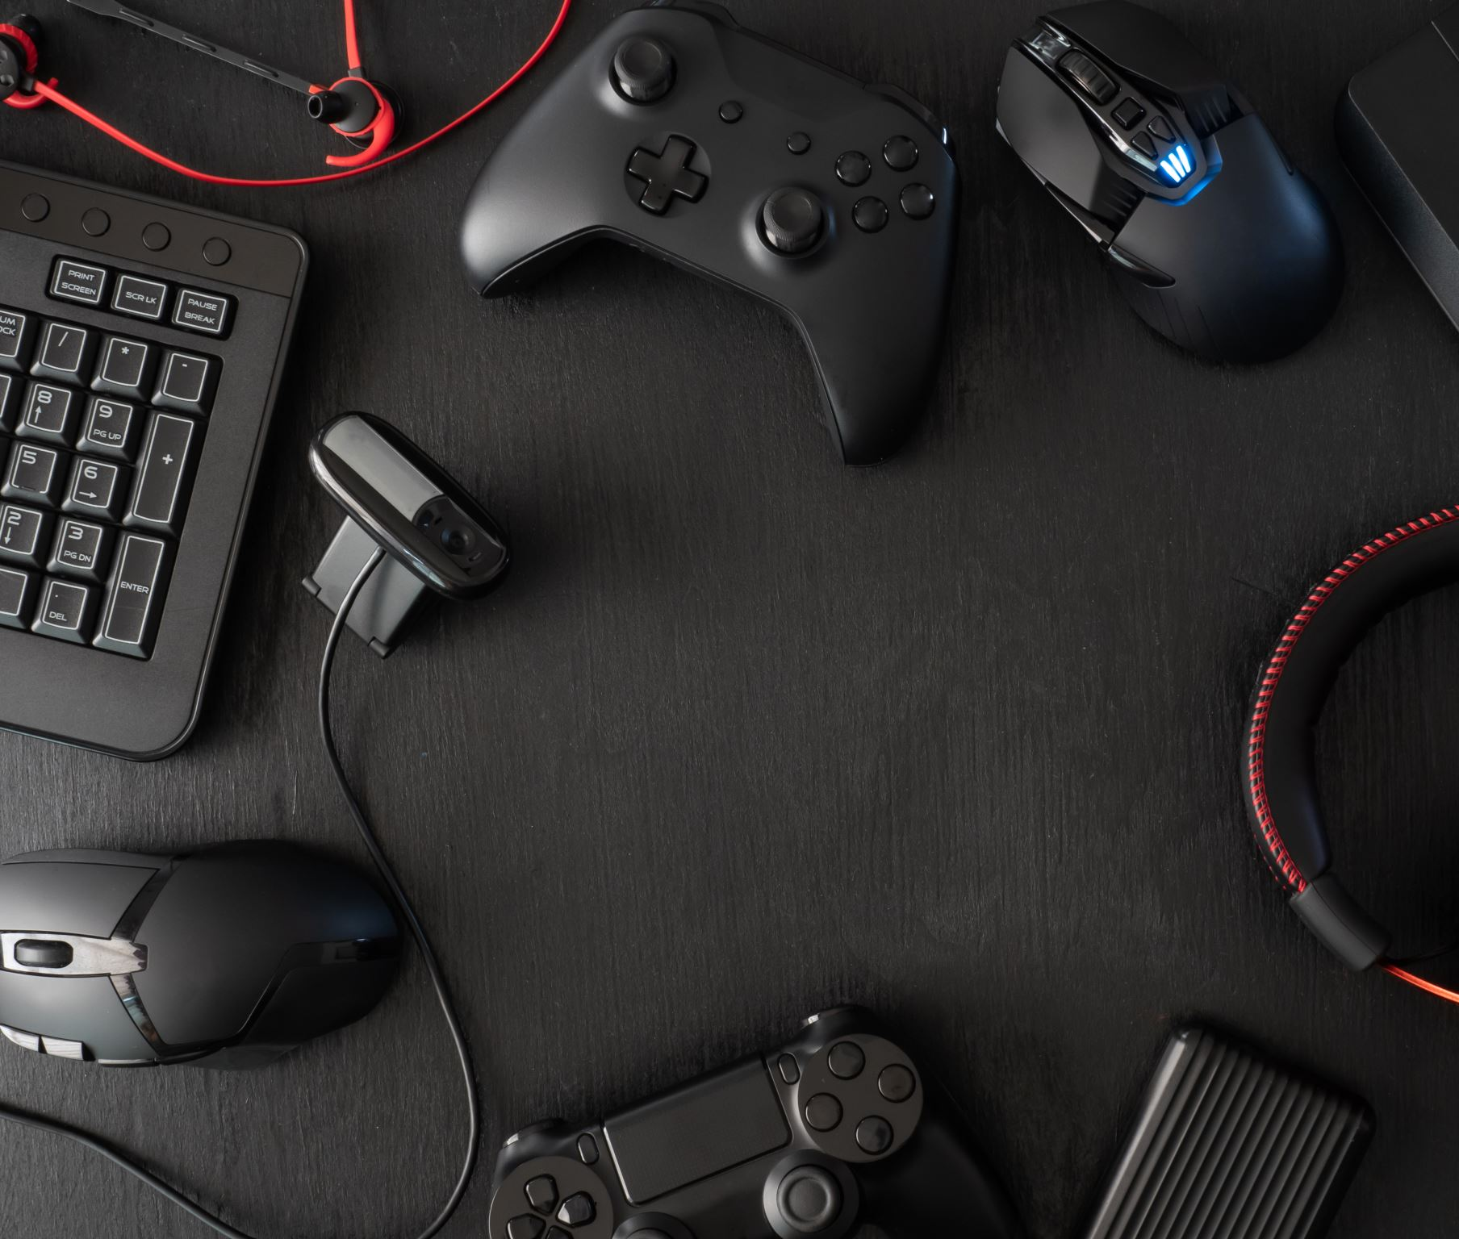
Current State of Accessibility in Gaming
What games do you view as being the most accessible and why?
What type of adaptive gaming equipment can be utilized for PC, XBox, and Playstation?
What organizations exist that focus on accessibility in gaming?

Slide 5
Utilizing Accessible Gaming Software
What type of accessibility software do you utilize when playing games?

Slide 6

Obtaining and Setting Up Adaptive Gaming Equipment
Where does someone obtain adaptive gaming equipment?
How do you setup adaptive gaming equipment? What are some of the challenges?

Slide 7
Accessible esports Tournaments and Leagues
What esports tournaments and leagues exist which are accessible for people with disabilities?
What type of challenges might people run into when competing in esports tournaments and leagues?

Slide 8
The Future of Accessibility in Gaming
What would you like to see for the future of accessibility over the next five years? Mike Matlock, Jared Grier, Dr. Tepper

Slide 9
Demonstration of Equipment
Xbox Adaptive Controller
Tobii Eye Gaze
Quadstick

Slide 10
Q & A

